Slide 1

Advocate Toolkit

Slide 2
Include a cover slide with info about Seahawk Marketplace, stats photos, and QR code to watch the South Campus Seahawk Marketplace opening?
1

Slide 3
HOW TO GET INVOLVED
In this season of giving, you can give the gift of education and encourage others to share in the spirit of giving.
MAKE A GIFT
Make a gift to support Seahawk Marketplace.
BECOME AN ADVOCATE (PAGES 3-4)
Advocates share the impact of the gift of a Broward College education with others and encourage participation among friends, family, and peers.
CREATE A MATCHING GIFT OR CHALLENGE (PAGES 5-7)
Inspire your friends to give by creating a matching gift or challenge.
GET SOCIAL (PAGE 8)
Follow us on social and spread awareness of the impact of the gift of education on
Broward College students.
2

Slide 4
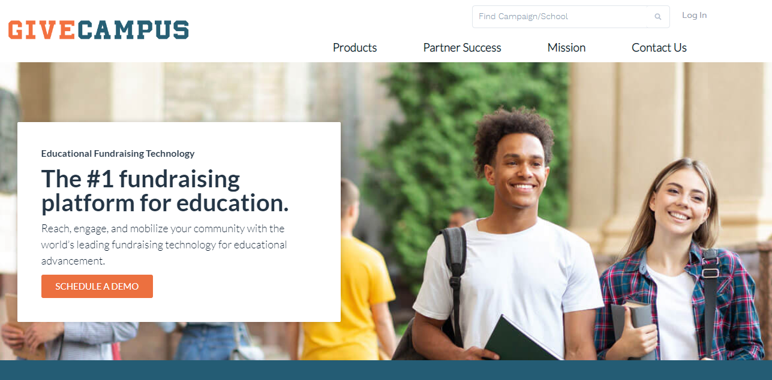
HOW TO BECOME AN ADVOCATE
Advocates are a huge piece of the success for making an impact. By creating a GiveCampus account and sharing about Seahawk Marketplace, you amplify the impact of support.
Make an impact by encouraging your classmates, family, and friends to support Broward College on GiveCampus!
It’s easy.
SET UP YOUR ACCOUNT
CREATE AN ACCOUNT (OR LOG IN)
We can only celebrate your hard work if we’re able to tell it’s you! We can do that by tracking outreach done when you’re logged into Give Campus.
Head to givecampus.com and click on ‘Log In’ at the top of the page.
Create an account from there!
3

Slide 5
BECOME AN ADVOCATE
STEP ONE:
Consider your own gift
STEP TWO:
Consider offering a Match or Challenge
Lead by example and make a gift. It’s much easier to ask your friends and family to join you in making a gift when you’ve already done it yourself!
Leverage your gift and encourage others to give via a match or challenge.
Consider restricting your match or challenge by your class year, affiliation, or to a list of your friends (by email address) to raise the stakes.
STEP THREE:
Share!
STEP FOUR:
Tell your story!
The built-in sharing buttons on the campaign page generate a link that is unique to you. If you share while you’re logged in, we can track it and celebrate your impact!
Share via Facebook, Twitter, Instagram, Text Message, Email, Phone Call, Carrier Pigeon…The sky’s the limit!
Create a Personal Plea and posit it to the campaign page!
Film a quick video in which you tell your community why you’re excited about making an impact on students through Seahawk Marketplace, and why others should get involved. Keep it quick, casual, and fun!
4

Slide 6
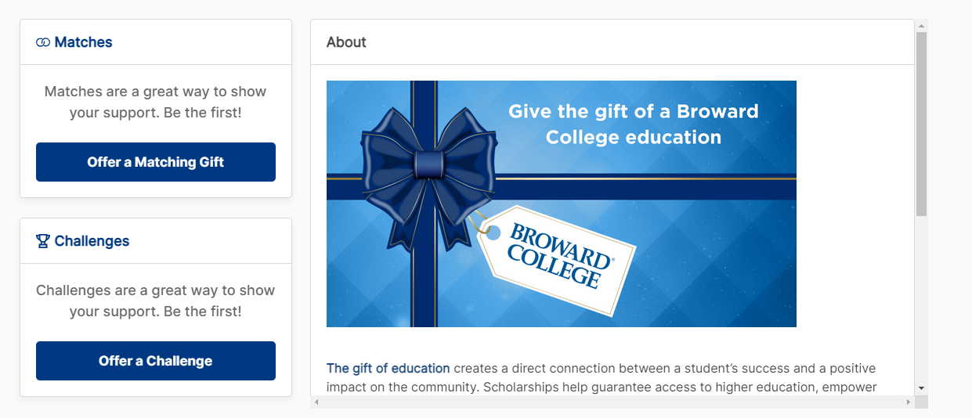
CREATE A MATCHING GIFT
Inspire your friends and classmates by creating a matching gift or challenge. Matches and challenges are similar; the key difference is that challenges are milestone-based (e.g. if 100 people make a gift, I will give $250) and matches are made on a donor basis (e.g. I will match up to $500 on a dollar-for-dollar basis for the next $500 that is donated).
Track your match’s progress by visiting the campaign page. Your match will be displayed on the Advocates tab as donors respond to your match.
To create a match, go to Broward College’s Seahawk Marketplace page and click on the appropriate button on the left side of the screen. (Need to add in new screenshot)
5

Slide 7
CREATE A MATCHING GIFT
Follow the instructions below to set up a matching gift.
STEP ONE:
STEP FOUR:
Track your match’s progress by visiting the campaign page. Your match will be displayed on the Advocates tab as donors respond to your match.
Enter how much you’d like to match up to (e.g. up to $150).
Most matches are not restricted, but you can choose if you like to restrict your match to only apply to fellow members of your class or to a list of friends.
STEP TWO:
Select if you want the match to be 1:1 match or if you click ‘other’, you can choose to donate another amount or a ‘per donor’ match.
STEP FIVE:
STEP THREE:
Enter your payment information. After you’ve created your match, encourage your friends and classmates to join you in supporting Broward College by sharing your personal advocate links.
Select when the match should end.
6

Slide 8
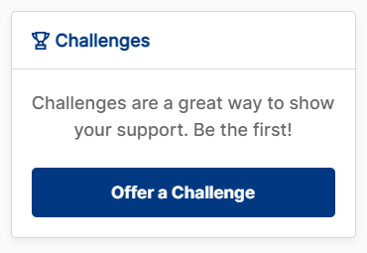
CREATE A CHALLENGE
To create a challenge, go to Broward College’s Seahawk Marketplace page and click on the appropriate button on the left side of the screen.
Track your challenge’s progress by visiting the campaign page. Recognition for your challenge will not display on the Advocates tab until your challenge is successful.
STEP ONE:
Enter how much you’d like to give.
STEP TWO:
Choose the milestone (e.g. donors or dollars).
STEP THREE:
Enter your payment information.
STEP FOUR:
After you’ve created your challenge, encourage your friends and classmates to join you in supporting Broward College.
7

Slide 9





GET SOCIAL!
Follow us on social and spread awareness of #SeahawkMarketplace! Tag us on Facebook, Twitter, LinkedIn, and Instagram and share using the hashtag #BrowardGives. Learn more about Seahawk Marketplace on Facebook @SeahawkOutreachServices.
facebook.com/ BrowardCollegeAlumni
@BrowardCollAlum
@browardcollegealumni
Broward College Alumni & Friends Network
Broward College Foundation
Utilize the “Share” buttons on the Seahawk Marketplace giving page to personalize your social posts and share why addressing food insecurities for students is important to you.
8

